Slide 1

CSE 470/598 Intro to OpenGL
Ross Maciejewski
rmacieje@asu.edu

Slide 2
Disclaimer
These slides can only be used as study material for the class 470 at ASU
The slides cannot be distributed or used for another purpose

Slide 3
main() Function
int main(int argc, char** argv)
{
// glut init
glutInit(&argc, argv);
glutInitDisplayMode (GLUT_SINGLE | GLUT_RGB);
// actual window size
glutInitWindowSize(500,500);
// initial window location, top-left corner
glutInitWindowPosition(0,0);
// create window with title “simple”
glutCreateWindow("simple");
// call mydisplay() function
glutDisplayFunc(mydisplay);
// call init() function
init();
// main event loop, do not use exit()
glutMainLoop();
}

Slide 4
Init() Function
void init()
{
glClearColor (0.0, 0.0, 0.0, 1.0); // black clear color, opaque window
glColor3f(1.0, 1.0, 1.0); // white
glMatrixMode (GL_PROJECTION);
glLoadIdentity ();
glOrtho2D(-1.0, 1.0, -1.0, 1.0); // screen size (-1.0,-1.0) to (1.0,1.0)
}

Slide 5
display() Function
void mydisplay()
{
glClear(GL_COLOR_BUFFER_BIT); // clear the window
glBegin(GL_POLYGON); // fill connected polygon
glVertex2f(-0.5, -0.5); // vertices of the square
glVertex2f(-0.5, 0.5);
glVertex2f(0.5, 0.5);
glVertex2f(0.5, -0.5);
glEnd();
}

Slide 6
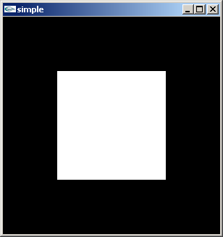
A Simple Program (?)
Generate a square on a solid background

Slide 7
Callbacks
Callback functions refresh
void (*func)(void) – what is this thing?
Virtually all interactive graphics programs are event driven
Glut/freeglut uses callbacks to handle events
Windows system invokes a particular procedure when an event of particular type occurs.
MOST IMPORTANT: display event
Signaled when window first displays and whenever portions of the window reveals from blocking window
glutDisplayFunc(void (*func)(void)) registers the display callback function

Slide 8
GLUT/freeglut Callbacks Overview
glutDisaplyFunc(void (*func)(void))
whenever GLUT/freeglut decides to redisplay the window, the registerd callback is executed.
glutReshapeFunc(void (*func)(int w, int h))
indicates what action should be taken when the window is resized.
glutKeyboardFunc(void (*func)(unsigned char key, int x, int y)) glutMouseFunc(void (*func)(int button, int state, int x, int y)) glutSpecialFunc(void (*func)(unsigned char key, int x, int y))
allow you to link a keyboard key or a mouse button with a routine that's invoked when the key or mouse button is pressed or released.
glutMotionFunc(void (*func)(int x, int y))
registers a routine to call back when the mouse is moved while a mouse button is also pressed.
glutIdleFunc(void (*func)(void))
registers a function that's to be executed if no other events are pending – use for animation or continuous update

Slide 9
Display Callback Code Example
glutDisplayFunc( display );
void display( void )
{
... ... ...
glBegin( GL_LINE_LOOP );
glVertex3fv( v[0] );
glVertex3fv( v[1] );
glVertex3fv( v[2] );
glVertex3fv( v[3] );
glEnd();
glutSwapBuffers(); // if double buffers used
}

Slide 10
Keyboard Callback Code Example
glutKeyboardFunc( keyboard );
void keyboard(unsigned char key, int x, int y )
{
switch( key ) {
case ‘q’ : case ‘Q’ :
exit(0); // exit the program
break;
case ‘r’ : case ‘R’ :
rotate += delta;
glutPostRedisplay(); // update the display
break;
}
}

Slide 11
Special Key Callback Code Example
glutSpecialFunc( specialKeys );
void specialKeys(unsigned char key, int x, int y )
{
switch( key ) {
case GLUT_KEY_F1: // F1 function key
red = 1.0;
green = 0.0;
blue = 0.0;
break;
case GLUT_KEY_UP: // up function key
movement = GL_TRUE;
break;
}
glutPostRedisplay();
}

Slide 12
Special Keys
GLUT_KEY_F1 F1 function key
… … …
GLUT_KEY_F12 F12 function key
GLUT_KEY_LEFT Left Arrow Key
GLUT_KEY_RIGHT Right Arrow Key
GLUT_KEY_UP Up arrow key
GLUT_KEY_DOWN Down arrow key
GLUT_KEY_PAGE_UP PgUp key
GLUT_KEY_PAGE_DOWN PgDn key
GLUT_KEY_HOME Home key
GLUT_KEY_END End key
GLUT_KEY_INSERT Insert key

Slide 13
Other Special Keys
int glutGetModifiers(void) to detect if any modifier key is pressed
glutKeyboardFunc( modifierKeys );
void modifierKeys(unsigned char key, int x, int y )
{
if (key == ‘r’) {
int mod = glutGetModifiers();
if(mod == GLUT_ACTIVE_ALT) // if ALT key
red = 0.0;
else
red = 1.0;
}
... ...
}
GLUT_ACTIVE_SHIFT SHIFT key
GLUT_ACTIVE_CTRL CTRL key
GLUT_ACTIVE_ALT ALT key

Slide 14
Mouse Function Callbacks
glutMouseFunc( mouseMovement );
void mouseMovement(int button,int state,int x,int y)
{
// button: GLUT_LEFT_BUTTON, GLUT_MIDDLE_BUTTON,
GLUT_RIGHT_BUTTON
// state: GLUT_DOWN, GLUT_UP
if (button == GLUT_LEFT_BUTTON &&
state == GLUT_DOWN)
{
startMovement = GL_TRUE;
// do something
}
mouseCurPositionX = x; // record mouse position
mouseCurPositionY = y;
mouseCurButton = button;
}

Slide 15
Mouse Motion Callback
glutMotionFunc( mouseMotion );
void mouseMotion(int x, int y)
{
if(mouseCurButton == GLUT_LEFT_BUTTON) {
x_angle += 360.0*(x-mouseCurPositionX)/width;
y_angle += 360.0*(y-mouseCurPositionY)/height;
}
if(mouseCurButton == GLUT_RIGHT_BUTTON)
scale += (y-mouseCurPositionY)/100.0;
mouseCurPositionX = x;
mouseCurPositionY = y;
glutPostReDisplay();
}
In display( ) we have …. ….. ….
glScalef (scale, scale, scale);
glRotatef (x_angle, 1.0f, 0.0f, 0.0f);
glRotatef (y_angle, 0.0f, 1.0f, 0.0f); … …. ….

Slide 16
Mouse Passive Motion Callback
glutPassiveMotionFunc(mousePMotion);
Almost as same function as the glutMotionFunc();
The (active) motion callback is called when the mouse moves within the window while one or more mouse buttons are pressed.
The (passive) motion callback is called when the mouse moves outside the window while one or more mouse buttons are pressed.

Slide 17
Double Buffering
Double buffering is necessary for almost all OpenGL applications:
Render into back buffer
Swap buffers when finished rendering a frame: The old back buffer becomes the front buffer that is displayed. The old front buffer becomes the back buffer that is rendered into.
What happens when you do not use double buffering?
flickering artifacts, tearing artifacts
Some commands:
glutInitDisplayMode( GLUT_RGBA | GLUT_DOUBLE );
glutSwapBuffers();

Slide 18
Exercises
OpenGL command syntax
Read Red Book(pdf): ch1
Understand OpenGL’s state machine model
Red Book(pdf):ch1 p18
Understand OpenGL’s client server model
An example, glFlush, Red Book(pdf): ch2 p32
Think about the differences between glFlush, glFinish, glutSwapBuffers. To better understand glFinish, think if you want to measure the exact rendering time of one frame on GPU.
Animation & Double buffering
Red Book(pdf): ch1 p24, explains double buffering and glutSwapBuffers
GLUT/freeglut (important!!!)(Everything in the book is compatible for freeglut)
Red Book(pdf): ch1 p21 - p28
Red Book Appendix D
Example 1-2, Example 1-3 (Animation)
Glut.h will show you the technical details

Slide 19
Questions?
Acknowledgements
Previous instructors of CSE 470/598
Peter Wonka, CS
Diane Hansford, CS
Purdue Colleagues
David Ebert, ECE
Niklas Elmqvist, ECE
Slides (Ed Angel)

Slide 20
CSE 470/598 Linear Algebra Review
Ross Maciejewski
rmacieje@asu.edu

Slide 21
Overview
Points and Lines
Vectors
Inner (Dot) Products
Cross Products
Orthonormal Basis
Change of Orthonormal Basis
Matrices and Operations

Slide 22
Points and Vectors
Points specify locations in space (or in the plane)
Vectors have a magnitude and direction
v
θ

Slide 23
Vectors
Vector
v
Magnitude or
Length
Unit Vector or
Normalized Vector

Slide 24
Vectors
Vector
Orientation
Zero Vector

Slide 25
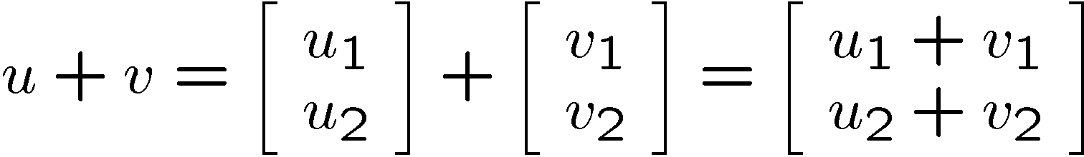
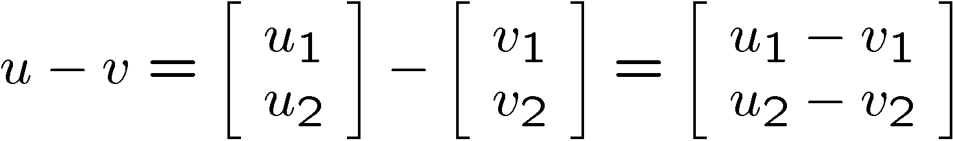
Vector Addition and Subtraction
u+v
v
u
u-v
u
v

Slide 26
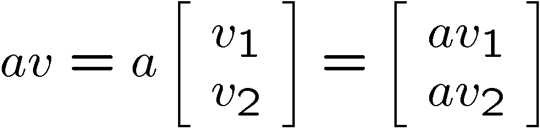
Multiplication with a Scalar
av
v
Notes:
26

Slide 27
Point or Vector ??
Point + Vector = ?
Vector + Vector = ?
Point – Point = ?
Point + Point = ?

Slide 28
Point or Vector
Point + Vector = Point
Vector + Vector = Vector
Point - Point = Vector
u
u
u-v
v-u
v
v
Point + Point = Not Defined

Slide 29
Dot Product
The dot product or inner product measures to what degree two vectors are aligned
Notation:
Computation:
Notes:
29

Slide 30
Dot Product
w
α
v
l
Geometric Interpretation:

Slide 31
Dot Product Calculation
Two vectors v and w are perpendicular or normal iff

Slide 32
Dot Product Calculation
Note: Length = Magnitude = 2-Norm = Euclidian Norm
Notes:
32

Slide 33
Dot Product Laws
Commutative law:
Distributive law:

Slide 34
Cross Product
Cross Product
Notation:
The cross product is a vector!
Magnitude of u: proportional to the sine of the angle between v and w
u is perpendicular to v and w
The direction of u follows the right hand rule
u
w
α
v

Slide 35
Cross Product Computation
Computation:

Slide 36
Cross Product Laws
Distributive law:
Commutative law:
Associative law:

Slide 37
Cross Product and Triangle Area
Q
R
P
The cross product is related to the area of a triangle

Slide 38
Triangle Area Example
Given a Triangle with P(2,3,-1), Q(-1,2,3) and R(3,1,-2)
What is the area?
Q
R
P

Slide 39
2D Lines

Slide 40
Defining a Line
Two elements of 2D geometry define a line
two points
a point and a vector parallel to the line
a point and a vector perpendicular to the line
Three different mathematical representations
parametric equation
implicit equation
explicit equation

Slide 41
Parametric Equation of a Line
(Note t is a scalar )
v
Parametric Line Equation:

Slide 42
Implicit Equation of a Line
Line equation:
Alternative notation
n
Notes:
42

Slide 43
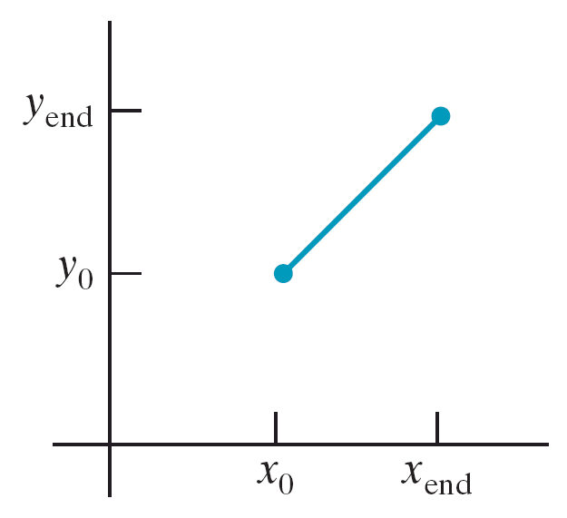
Slope Intercept Line Equation
line equation: y = m*x + b
line path between two points:
y_{end} − y₀
m =
x_{end} − x₀
b = y₀ − m.x₀

Slide 44
Distance between a point and a line
Use the line equation:
Divide the line equation by the length of n
Compute the absolute value of:
p
n
Notes:
44

Slide 45
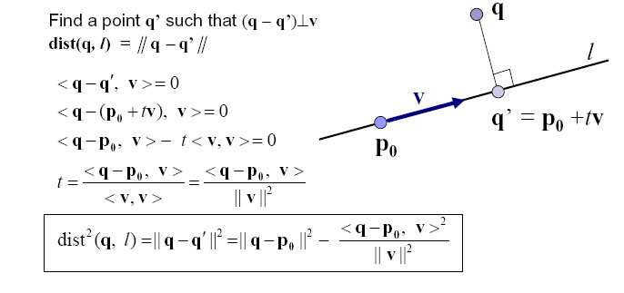
Derivation
Notes:
45

Slide 46
Matrices

Slide 47
Matrix
A matrix is a set of elements, organized into rows and columns
rows
columns

Slide 48
Matrix Addition
Addition
General Form
Example
Notes:
48

Slide 49
Matrix Subtraction
Subtraction

Slide 50
Matrix Multiplication
Multiplication
Multiply each row by each column

Slide 51
Matrix Multiplication
Multiplication:
A and B must have compatible dimensions
Examples:

Slide 52
Transpose
Notation:
Definition:
Examples:
Notes:
52

Slide 53
Rules
Notes:
53

Slide 54
Symmetric Matrices
A is symmetric iff

Slide 55
Determinants
Determinant (Note A must be square)
Example

Slide 56
Inverse Matrices
Notation
I is the Identity (1s on the diagonal, 0s elsewhere)
Inverse Computation:

Slide 57
Matrices
Example

Slide 58
Orthonormal Basis

Slide 59
Orthonormal Basis
Basis: a space is totally defined by a set of vectors – any point is a linear combination of the basis
Ortho-normal: orthogonal + normal
Orthogonal: dot product is zero
Normal: magnitude is one
Example:

Slide 60


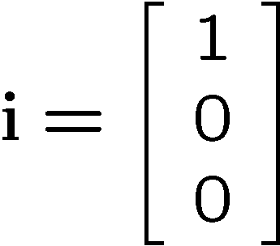
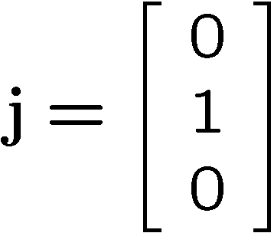
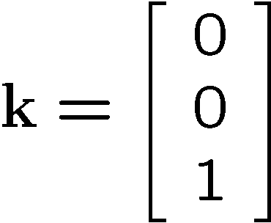





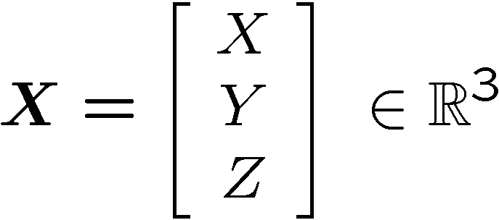
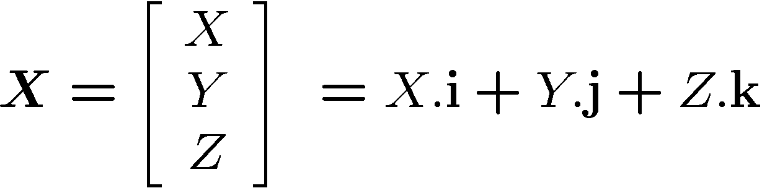
Orthonormal Coordinate in 3D
Standard basis vectors:
Coordinates of a point in space:

Slide 61
Change of Orthonormal Basis
How do we express any point as a combination of a new basis U, V, N, given X, Y, Z?
v
y
x
p
Given:
coordinate frames xyz and uvn
point p = (px, py, pz)
Find:
p = (pu, pv, pn)
v
u
u
y
x
y
v
p
u
n
x
z

Slide 62
Change of Orthonormal Basis
pu
pv
pn
ux
vx
nx
uy
vy
ny
uz
vz
nz
px
py
pz
px
py
pz
=
= M
What's M⁻¹, the inverse?
px
py
pz
xu
yu
zu
xv
yv
zv
xn
yn
zn
pu
pv
pn
ux = x . u = u . x = xu
=
M⁻¹ = M^{T}
Matrix A (n×n) is orthogonal if A⁻¹ = A^{T}

